Slide 1
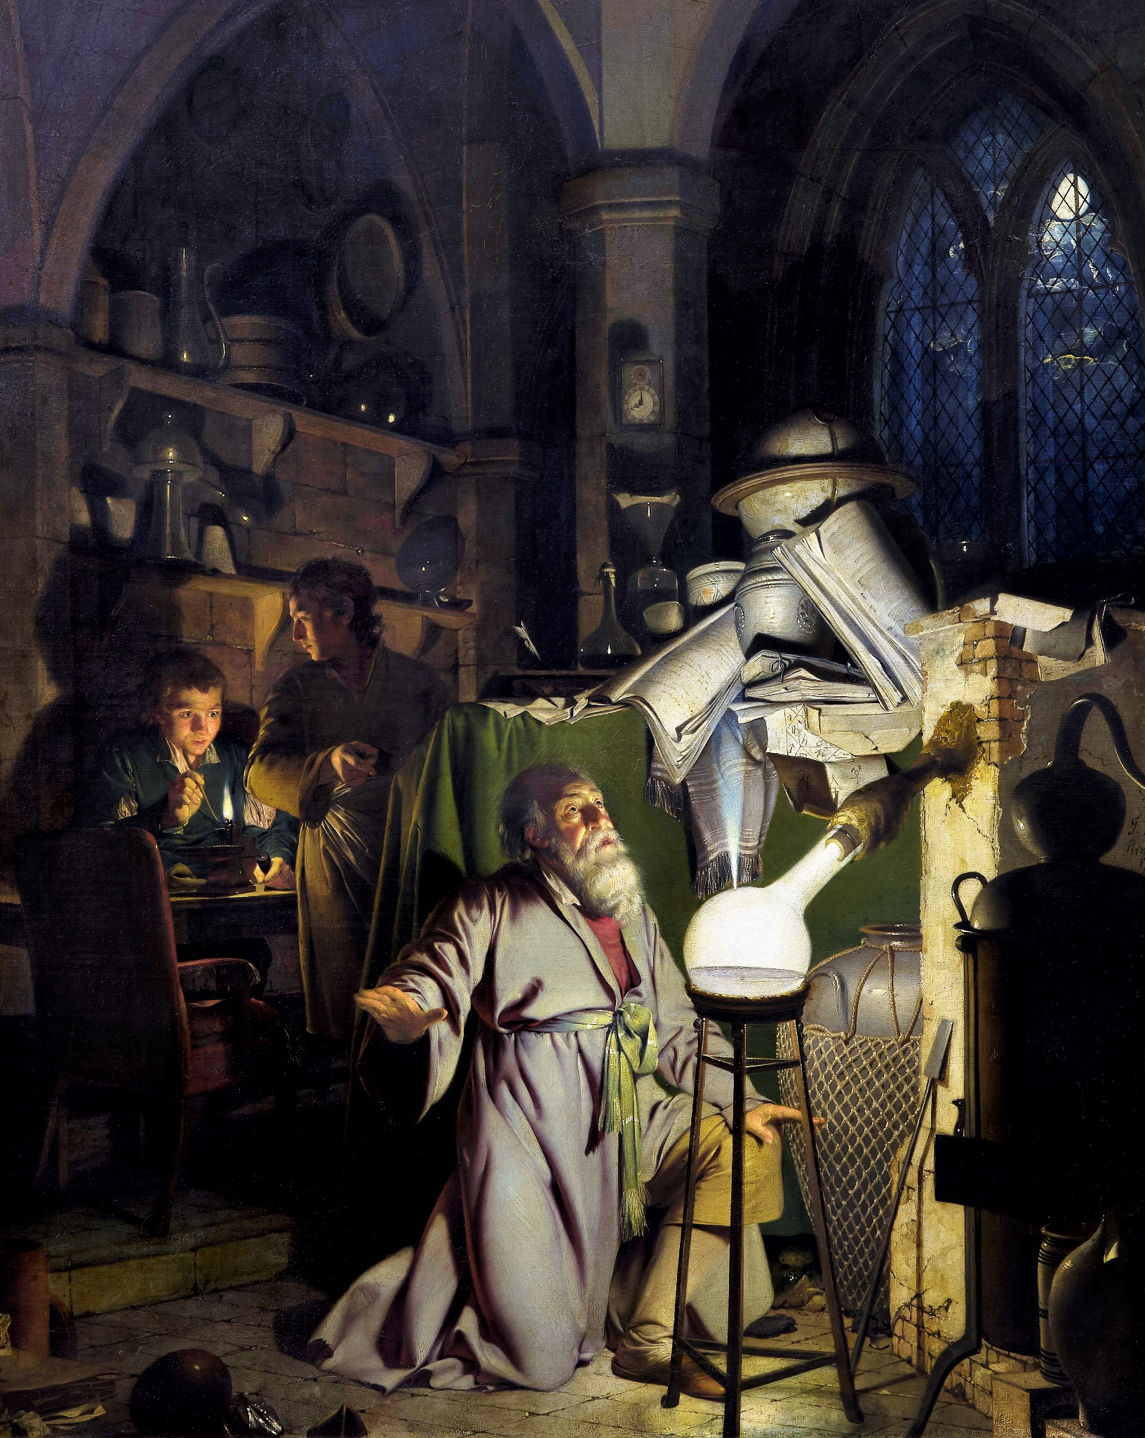

Acquire, manage & reference knowledge
IL “Scientific Method and Analysis” WS 25-26
Kami Höferl
(Wright of Derby , Wikimedia, PD)
Notes:
"The Alchemist in Search of the Philosopher’s Stone" by Joseph Wright of Derby (1771)
substance capable of turning base metals such as mercury into gold or silver[
In this work, Wright captures an alchemist conducting an experiment with a crucible in search of the philosopher’s stone. The painting portrays a moment of discovery and highlights the experimental process central to early chemistry, before the formalization of modern science.

Slide 2
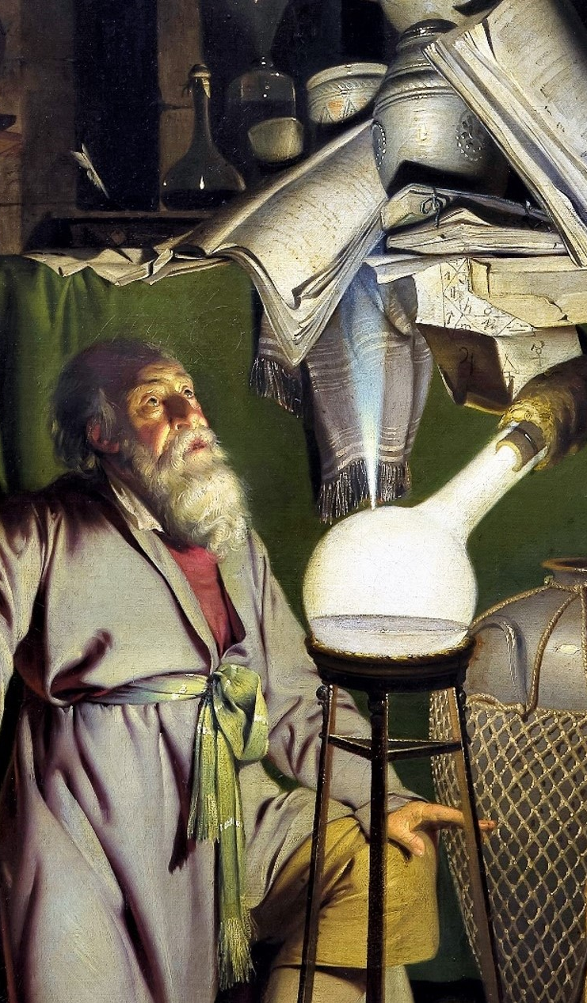
Overview
Types of Literature
Finding Literature & Data
Acquiring Knowlede from Literature
Citing Materials
1. Assignment

Slide 3
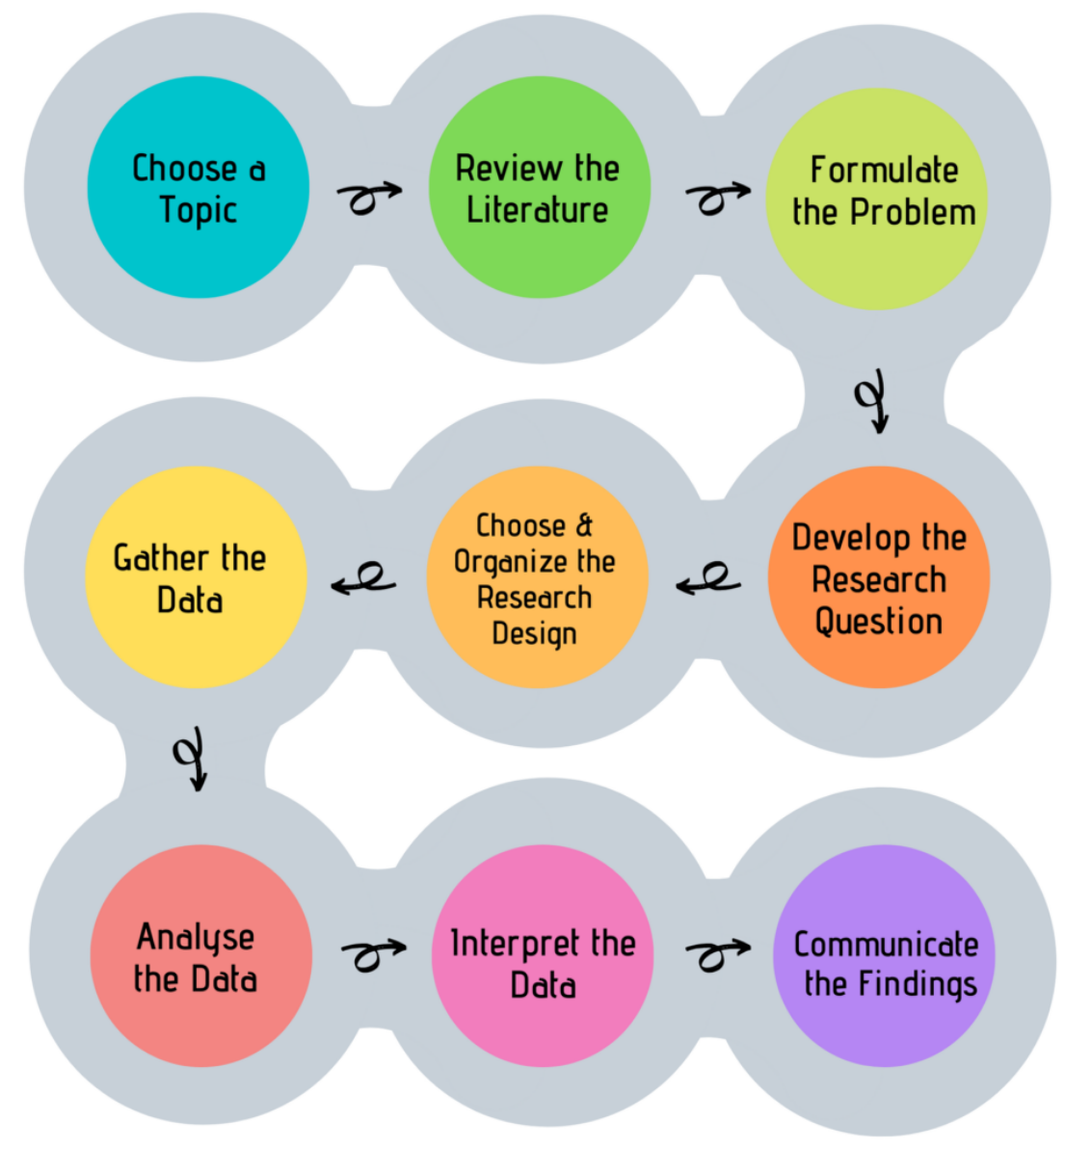
Look, Think, Test, Tell
👉 Main goal:
Understand scientific method

Slide 4
Let’s get started

Slide 5
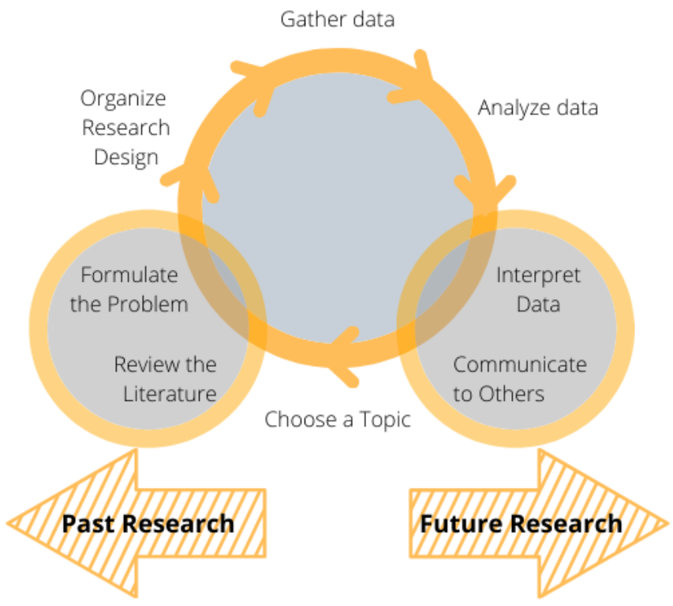
Another look at the research process

Slide 6
Quality criteria in science
Quality Criteria
Objectivity
Honesty
Verifiability
Reliability
Validity
Comprehen-sibility
Relevance
Logical Argumen-tation
Originality
Reproduci-bility

Slide 7
Another look at the research process

Slide 8
Step 1: Choos a topic
Ideal:
Based on your interests
Based on a peers recommendation
👉 If you are not sure: Talk to your peers & lecturers
Not so ideal:
Because of funding

Slide 9
Another look at the research process

Slide 10
Step 2: Review the literature
🤔

Slide 11
Start with why
Become familiar with a field of research.
Provide a context for your research.
Justify the research you are proposing.
Ensure that your proposed research has not been carried out by another person (and if you find it has, then your literature review should specify why replication is necessary).
Show where your proposed research fits into the existing body of knowledge.
Enable the researcher to learn from previous theories on the subject.
Illustrate how the subject has been studied previously.
Highlight flaws in previous research.
Outline gaps in previous research.
Show how your proposed research can add to the understanding and knowledge of the field.
Help refine, refocus, or even move the topic in a new direction.

Slide 12
But where is “the” knowledge?
Fields of scientific knowledge:
Causal explanations & descriptions of phenomena*
Foundational Concepts and Theories
Eg. Laws of Thermodynamics
Research Methodologies
Qualitative & quantitative Methods
Scientific Processes
Formation of questions & hypothesis
Experimentation
Data analysis
Peer review
Ethics & standards

Slide 13
Here:
Sum of all formal outcomes:
Academic Publications: Peer-reviewed journals, monographs
Conferences: Oral presentations, posters, workshops
Digital Repositories: Institutional & subject-specific platforms (ResearchGate, Zenodo, arXiv etc.)
General Publications: Books, magazines, popular science
Media & Press: Press releases, science journalism, radio/TV
Public Engagement: Lectures, science fairs, outreach workshops
Education: University courses, online courses, science kits
Social Media: Blogs, Videos, podcasts
Policy Briefs: Summaries for policymakers, white papers
Industry & Non-Profits: Applied research partnerships, NGO reports

Slide 14
Quality criteria in science
Quality Criteria
Objectivity
Honesty
Verifiability
Reliability
Validity
Comprehen-sibility
Relevance
Logical Argumen-tation
Originality
Reproduci-bility

Slide 15
White vs. grey literature
Here’s a comparison of the characteristics of white and grey academic literature:
Key Takeaway:
White Literature: Rigorous, peer-reviewed, and academic in nature, best for theoretical and empirical research.
Grey Literature: Practical, timely, and less formal, often addressing niche or emerging issues. It is valuable but requires careful evaluation for credibility.
White Literature:
Academic, formal
peer-reviewed / editorial standards
Grey Literature:
Practical, timely & less formal
addressing niche or emerging issues
👉 careful evaluation for credibility

Slide 16
White vs. grey literature
Here’s a comparison of the characteristics of white and grey academic literature:
Key Takeaway:
White Literature: Rigorous, peer-reviewed, and academic in nature, best for theoretical and empirical research.
Grey Literature: Practical, timely, and less formal, often addressing niche or emerging issues. It is valuable but requires careful evaluation for credibility.
Aspect | White Academic Literature | Grey Academic Literature
Definition | Peer-reviewed, formally published academic work. | Research or reports not formally published or peer-reviewed.
Examples | Journal articles, books, conference papers. | Technical reports, theses, white papers, policy briefs.
Publication Process | Strict peer-review and editorial standards. | Limited or no peer review; may be self-published.
Accessibility | Typically available through academic journals or libraries. | Often harder to access; found in institutional repositories or online.
Credibility | High, as it undergoes rigorous quality control. | Varied; credibility depends on the source and authorship.
Intended Audience | Academics, researchers, and experts in the field. | Policymakers, practitioners, or niche audiences.
Timeliness | Slower to publish due to rigorous review. | Often more current, providing recent or emerging findings.
Citations | Highly cited in scholarly works. | Less frequently cited, but influential in specific contexts (e.g., policy).
Scope | Focused on theoretical, experimental, or empirical studies. | Practical, technical, or policy-oriented studies.
Permanence | Archival and widely distributed. | May lack long-term archiving and be difficult to locate over time.

Slide 17
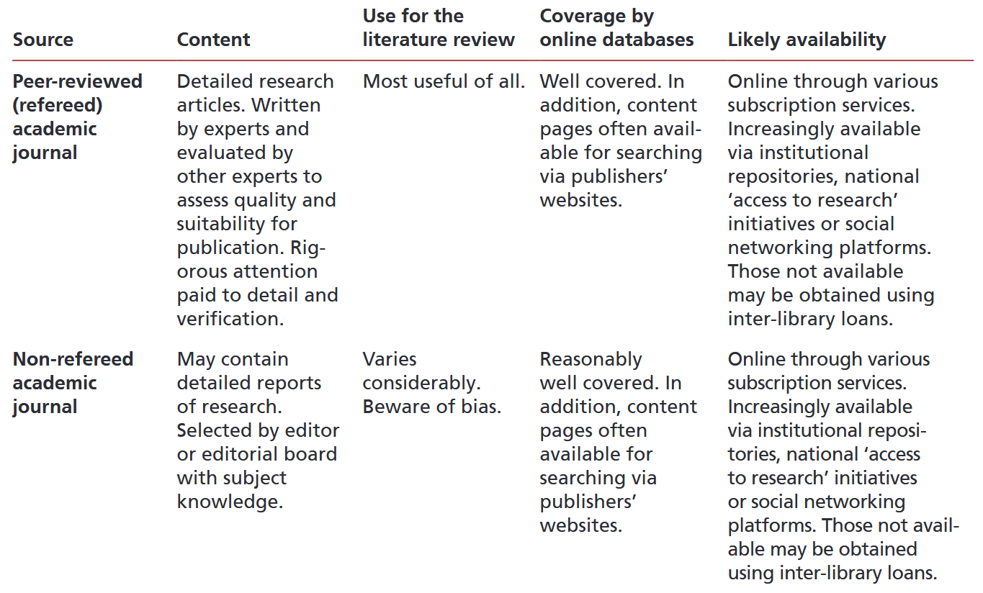
What literature is there?

Slide 18
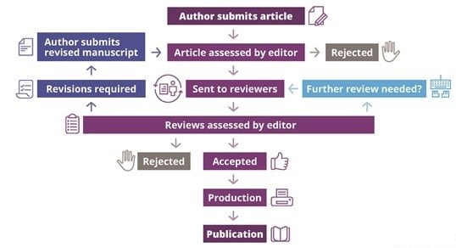
Peer review?

Slide 19
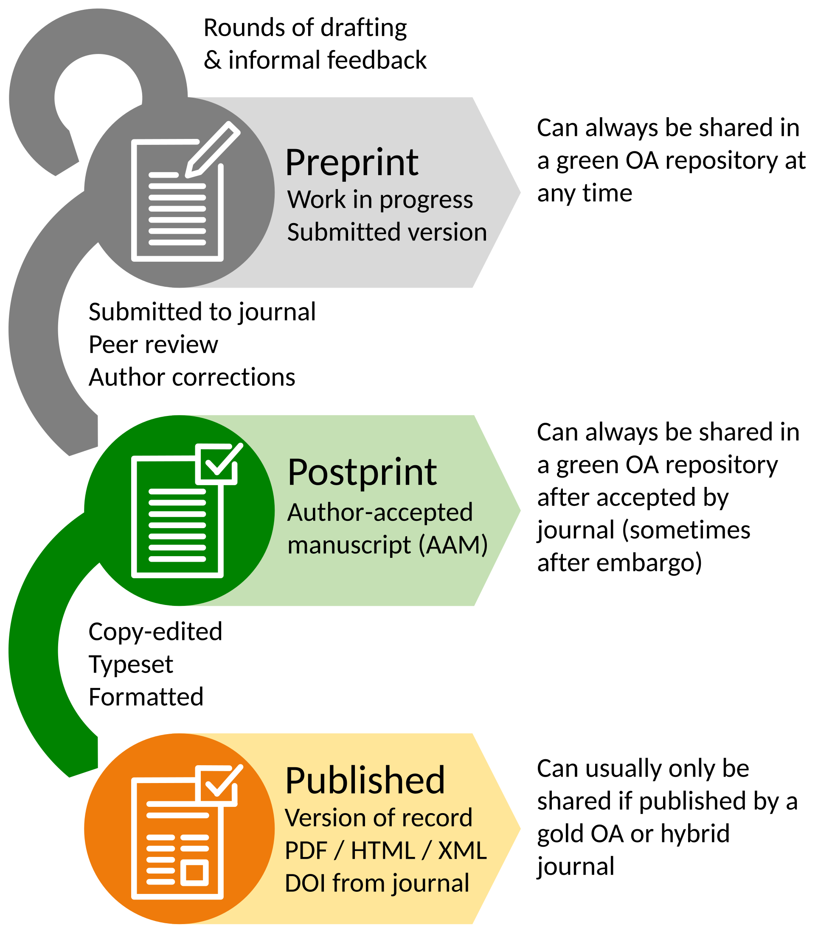



The before & after peer review

Slide 20
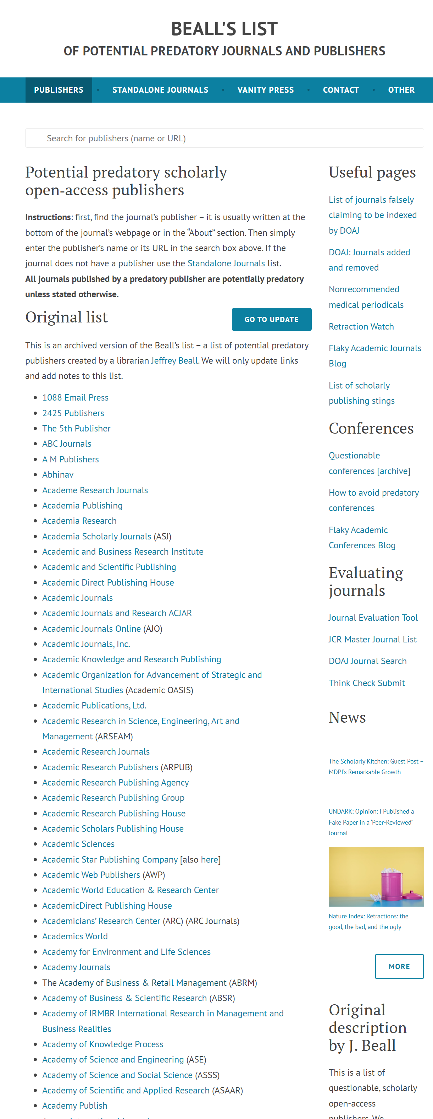
Beware: Predatory journals
deceptive publications that exploit researchers by charging high fees for publishing without providing legitimate editorial and peer-review processes

Slide 21
Another layer of complexity: Open/Closed Access
Aspect | Open Access | Closed Access
Access | Free to read for everyone online. | Requires a subscription or pay-per-view access.
Cost for Authors | Authors often pay Article Processing Charges (APCs). | No direct cost for authors; costs covered by subscriptions.
Audience Reach | Accessible to the public and researchers globally. | Limited to subscribers, institutions, or paywall access.
Visibility | High; easily discoverable and shareable. | Restricted; limited audience and accessibility.
Speed of Dissemination | Often faster publication due to online-first focus. | Slower, as access is tied to subscription releases.
Examples | PLOS ONE, BioMed Central. | Elsevier’s subscription journals, Wiley, Springer.
Funding Sources | Author fees, institutional support, or public grants. | Subscription revenue from individuals or libraries.
Ethical Aspect | Promotes equitable access to knowledge. | Knowledge access is restricted by economic barriers.

Slide 22
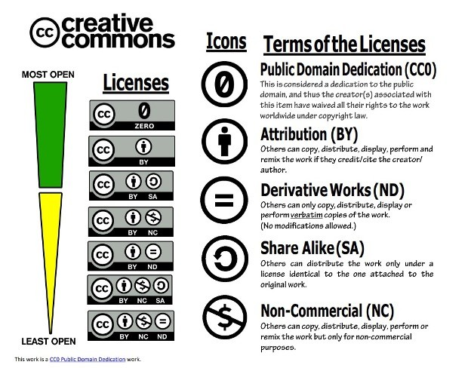
Open Access: All about licences

Slide 23
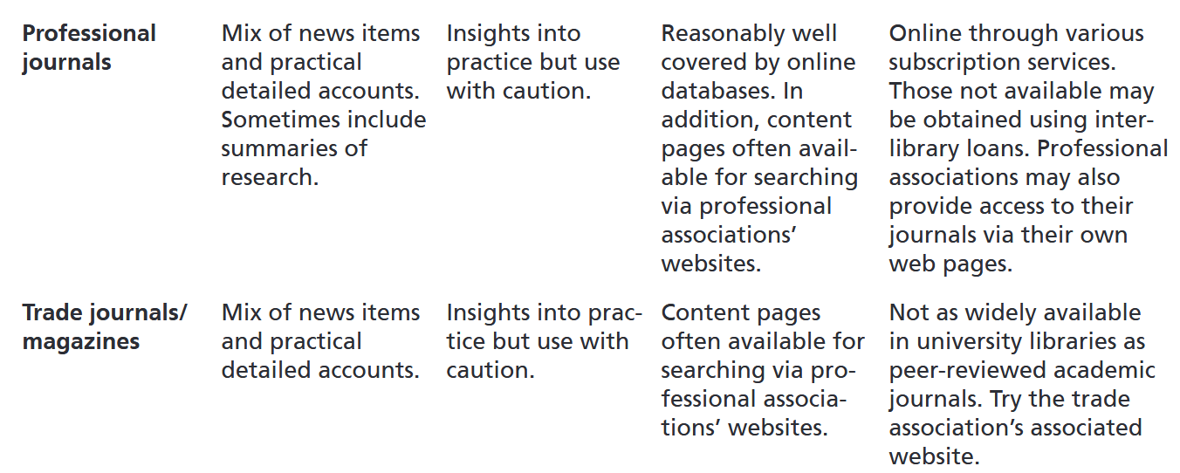
What literature is there?

Slide 24
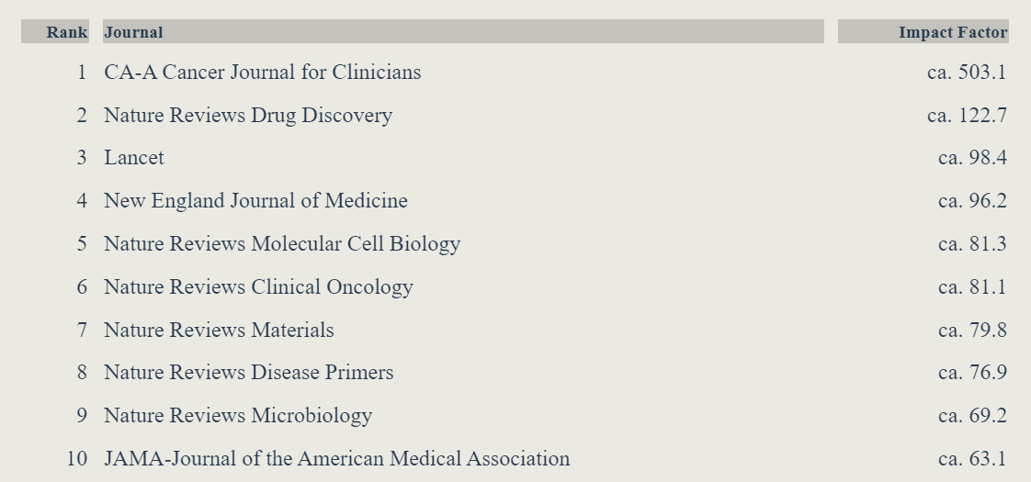
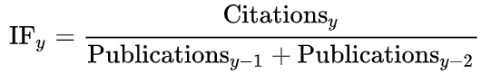
What is a “good” journal?
Impact Factor(IF)*:
“reflects the yearly mean number of citations of articles published in the last two years in a given journal, as indexed by Clarivate's Web of Science.” (Wikipedia, 2024)

Slide 25
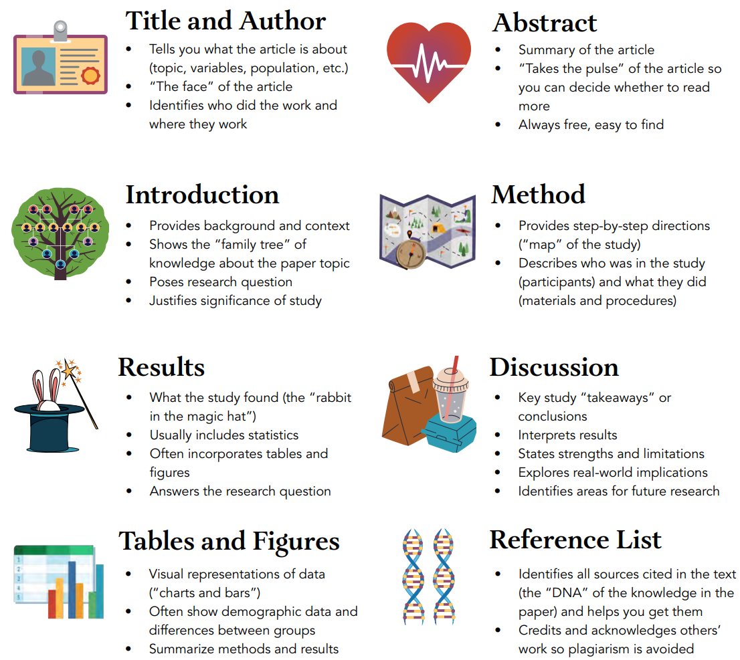
Structure of a “good” journal article

Slide 26
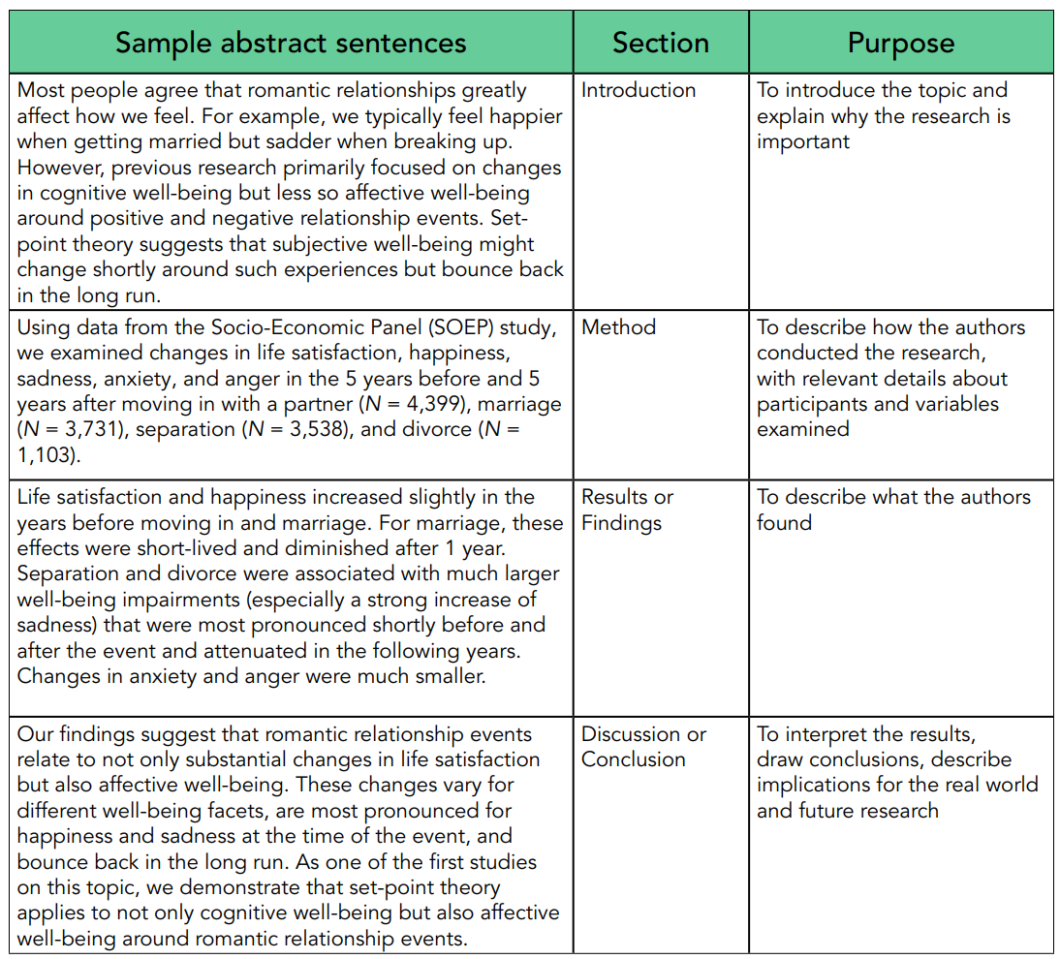
Most important: The abstract

Slide 27
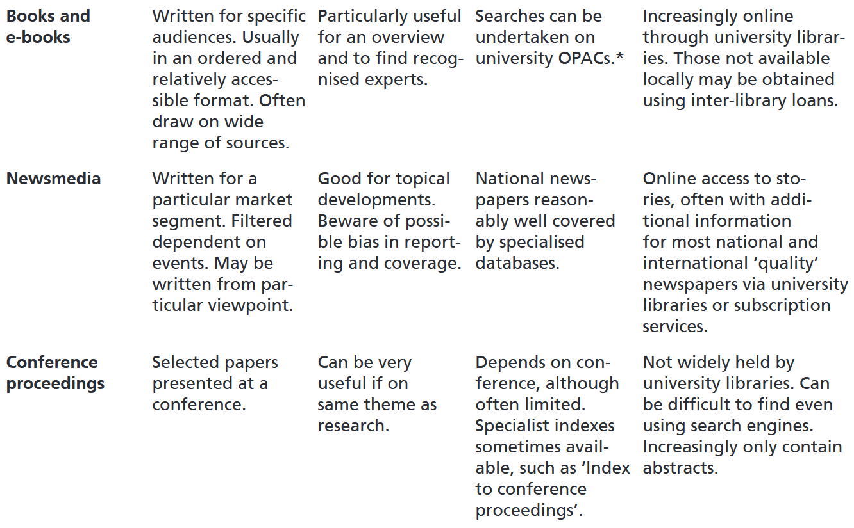
What literature is there?

Slide 28
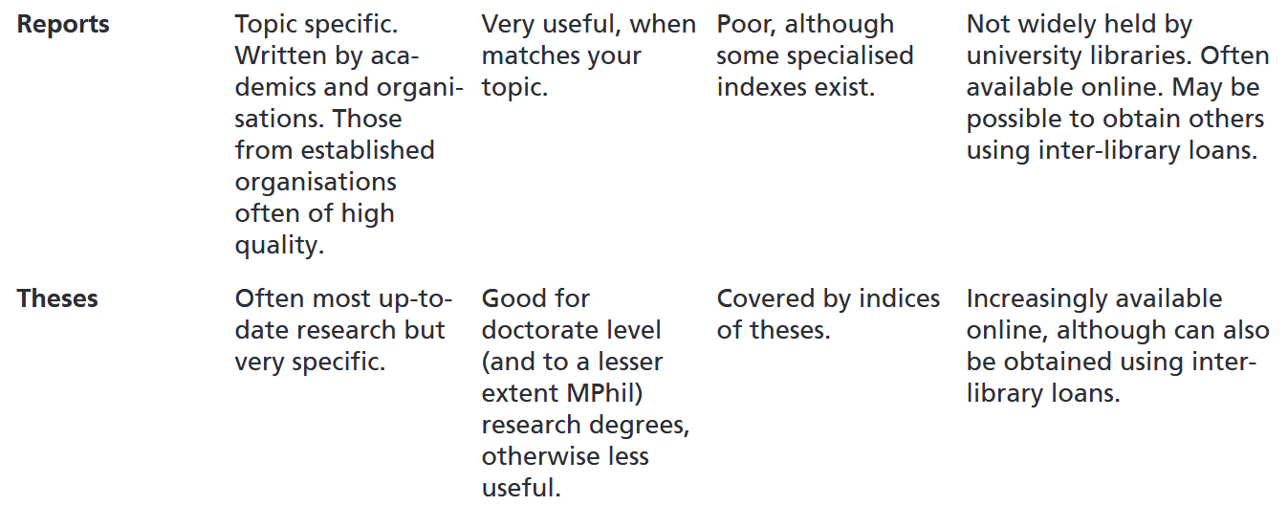
What literature is there?

Slide 29
What literature is there?

Slide 30
Here:
Sum of all formal outcomes:
Academic Publications: Peer-reviewed journals, monographs
Conferences: Oral presentations, posters, workshops
Digital Repositories: Institutional & subject-specific platforms (ResearchGate, Zenodo, arXiv etc.)
General Publications: Books, magazines, popular science
Media & Press: Press releases, science journalism, radio/TV
Public Engagement: Lectures, science fairs, outreach workshops
Education: University courses, online courses, science kits
Social Media: Blogs, Videos, podcasts
Policy Briefs: Summaries for policymakers, white papers
Industry & Non-Profits: Applied research partnerships, NGO reports

Slide 31
How 2 find Literature & Data

Slide 32
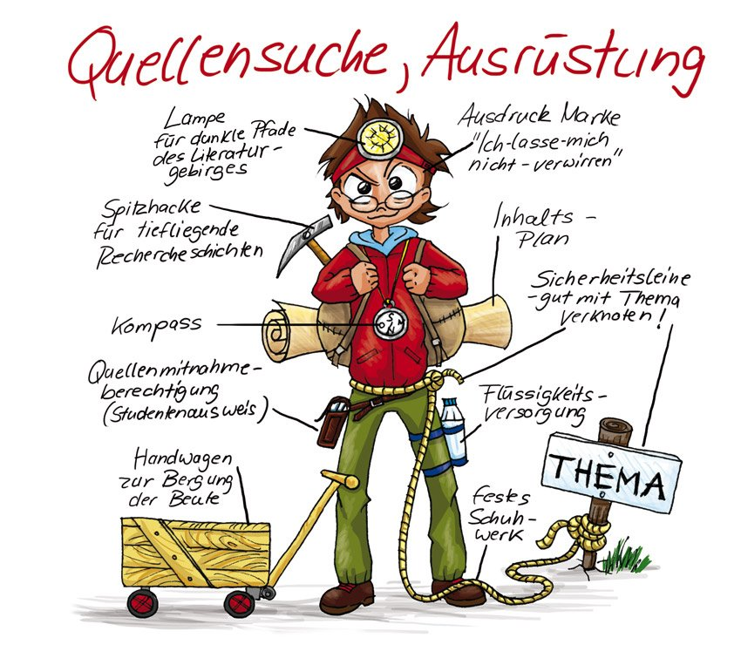
Well …

Slide 33

Well …

Slide 34
Well …
Old school: Search on the shelf
Electronic catalogues:
IMC:
PRIMO: https://search-duk.obvsg.at/
Österr. Bibliothekenverbund: http://search.obvsg.at/OBV
Worldwide:
Karlsruher Virtueller Katalog: https://kvk.bibliothek.kit.edu/
Worldcat: http://www.worldcat.org/
Interlibrary loans:
IMC: https://www.donau-uni.ac.at/de/universitaet/service/bibliothek/ressourcenbestellung.html
Google Books / Scholar
http://books.google.com / https://scholar.google.at

Slide 35
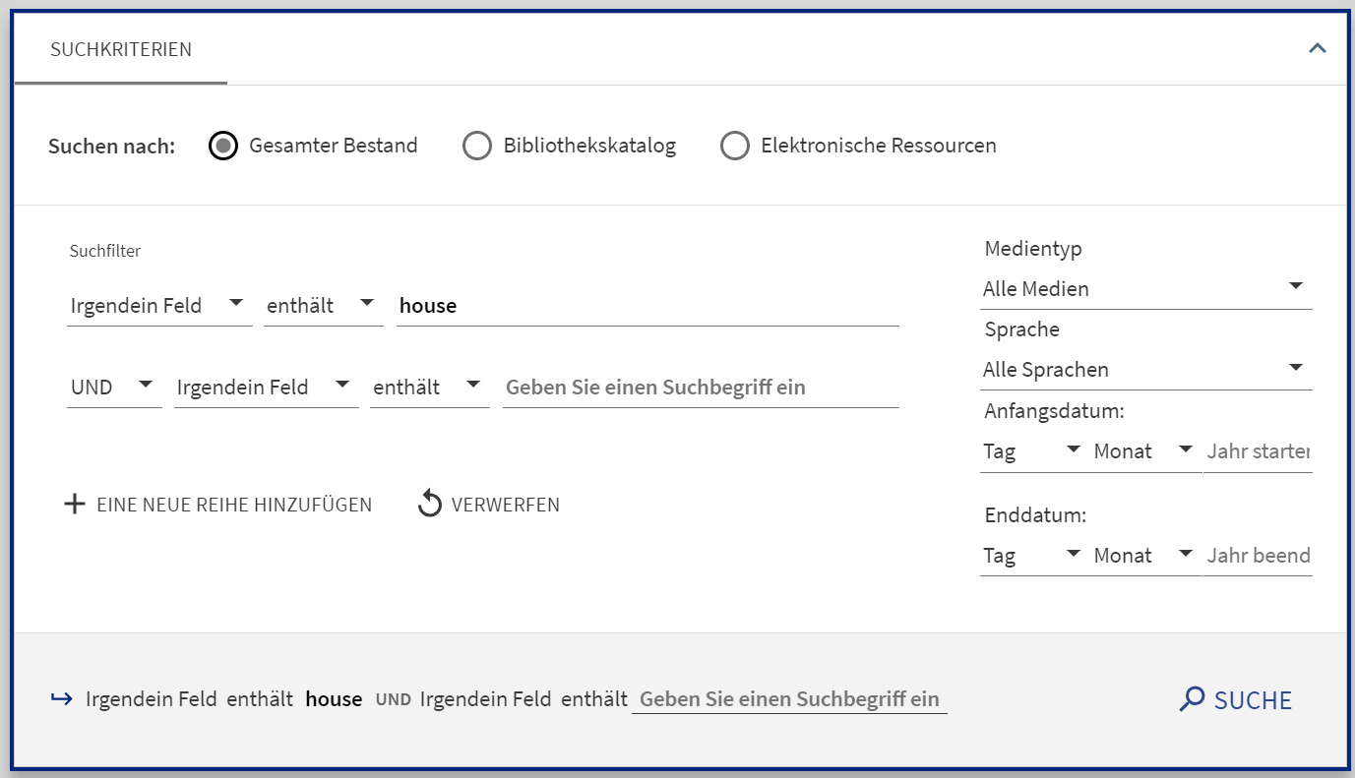
Digression: Talking to computers
and = intersection
Hits that contain both term A and term B
or = common set
Hits that contain either term A or term B
and not = exclusion set
Hits that contain term A but not term B
→ "()" for nesting search arguments
→ "*" as a placeholder

Slide 36
Meta-portals of big publishers
Elsevier „ScienceDirect“: http://www.sciencedirect.com/
Springer „SpringerLink“: http://www.springerlink.com/
Taylor and Francis: http://www.tandfonline.com/
Emerald: https://www.emerald.com/insight/

Slide 37
Do we have this journal?
Local:
Elektronische Zeitschriftenbibliothek (EZB) https://ezb.uni-regensburg.de/?bibid=DUK
Austria-wide:
Österreichischer Bibliothekenverbund – Teilkatalog Zeitschriften und Serien: http://opac.obvsg.at/acczs

Slide 38
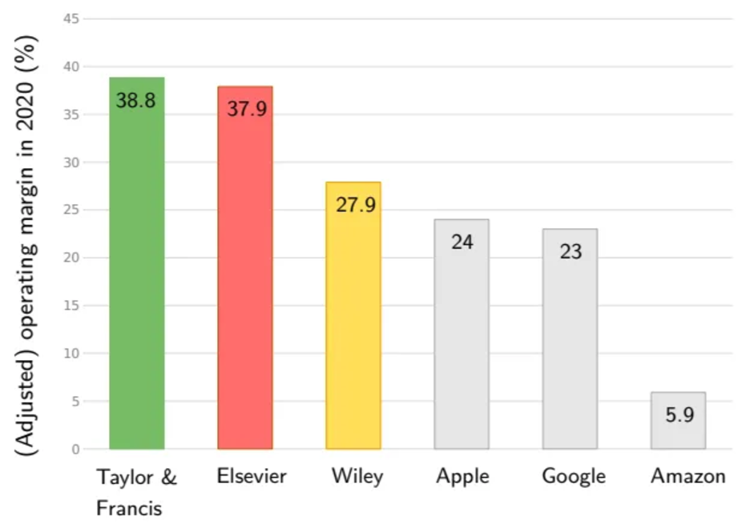
Digression: Closed & open access?
Closed Access:
Research articles = available only to subscribers or institutions that pay for access
👉 limiting public availability
Open Access:
Research articles = freely available to anyone online
👉 wider dissemination & accessibility without paywalls
Notes:
Elsevier: 2023 adjusted operating profit of £3 billion (3,5 billion)

Slide 39
Commercial academic search services
ISI Knowledge: http://www.isiknowledge.com
JSTOR – Archive: http://www.jstor.org/
Google Scholar: http://scholar.google.com
Ai based search engines:
Science.os: https://www.scienceos.ai/
Consensus: https://consensus.app/
…

Slide 40
Academic repositories
General purpose repositories:
arXiv: https://arxiv.org/
Zenodo: https://zenodo.org/
Disciplinary repositories:
Social Sciences Research Network (SSRN): https://papers.ssrn.com/
bioRxiv: https://www.biorxiv.org/
ECONSTOR: https://www.econstor.eu/
Institutional repositories:
University of Vienna: https://uscholar.univie.ac.at/
…

Slide 41
Do not rush into searching
Depending on your pre-exiting knowledge:
0 to little:
Find a textbook on the topic
Follow up on referenced authors, methods, theories, etc.
Medium to pro: 👉 boundaries of your search
Subject area
Authors & institutions
Type of literature
Time frame
Geograhical and/or historical scope
Language
Warm-up with review articles!

Slide 42
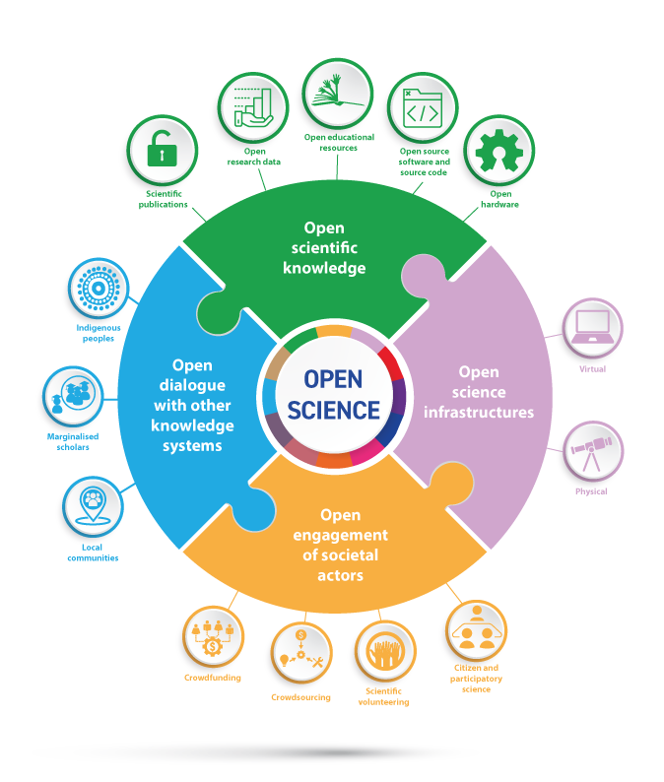
Not just literature …
👉 Data
Software
Code
Hardware

Slide 43
Finding data
Österreich:
Open Data: https://www.data.gv.at
Statistik Austria: http://www.statistik.at
Geodaten: http://www.geoland.at
Südtirol - ASTAT: http://www.provinz.bz.it/astat/de
Deutschland - Statistisches Bundesamt : http://www.destatis.de/
Schweiz – Bundesamt für Statistik: www.bfs.admin.ch

Slide 44
Finding data
GESIS - Leibniz-Institut für Sozialwissenschaften: https://www.gesis.org/home/
FAO - Food and Agriculture Organisation: http://faostat.fao.org
UNDP: Human Development Reports: http://hdr.undp.org/en/statistics
Weltbank - Data & Statistics: http://www.worldbank.org/data
CIA - The World Factbook: https://www.cia.gov/the-world-factbook/
WTO - International trade and tariff data: http://www.wto.org/english/res_e/statis_e/statis_e.htm
EM-DAT - Emergency Events Database: http://www.emdat.be

Slide 45
What to do with it

Slide 46
Well … read it!
„Man wähle die schickliche Zeit ... lese ohne vorgefasste Meinung ... sammle sich und hüte sich vor Zerstreuung ... lese mit dem Bleistift in der Hand ... unterbreche nicht mitten im Zusammenhang ... schreibe den Hauptinhalt kurz nieder ... exzerpiere erst nach dem Lesen ... unterhalte sich mit Freunden über das Gelesene ... sei auf der Hut sein Urteil nicht durch Machtsprüche des Verfassers bestimmen zu lassen ... man lese nacheinander Autoren mit unterschiedlicher Meinung zum selben Gegenstand ... ” (Burchert und Sohr 2008: 58)
Ratschläge zur Lektüre wissenschaftlicher Literatur von: Kiesewetter, J. G. (1811): Lehrbuch der Hodegetik oder kurze Anweisung zum Studieren. Berlin.

Slide 47
A straight process?
Learn
Organise
Write
Search
Read

Slide 48
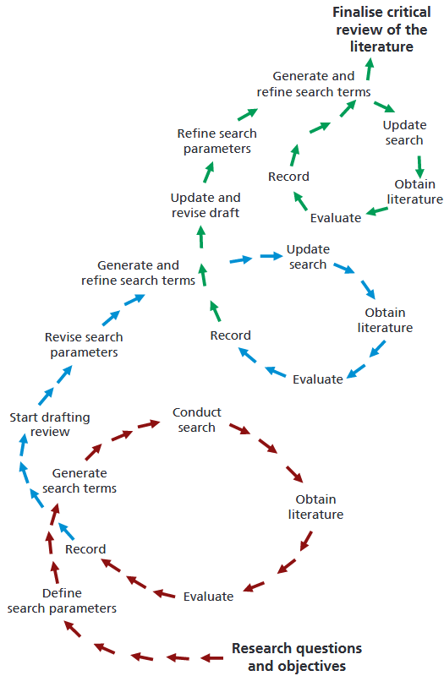
A straight process?

Slide 49
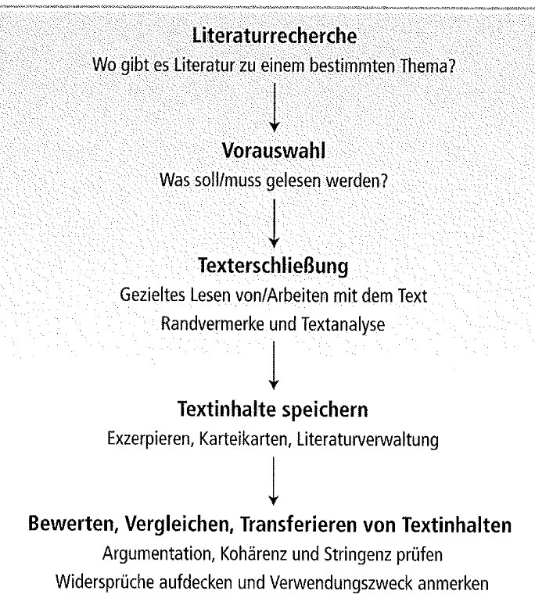
What does this mean for my 3,523 hits?

Slide 50
A. Preselection of literature: Cross reading
Ask yourself before reading:
Why am I reading this text?
Introduction, overview of a topic
Deepening a topic
Author's opinion
Data/facts
What do I want to know from this text?
Specific question(s): Who, what, where, when, how, why, etc.
Is the text relevant to me?

Slide 51
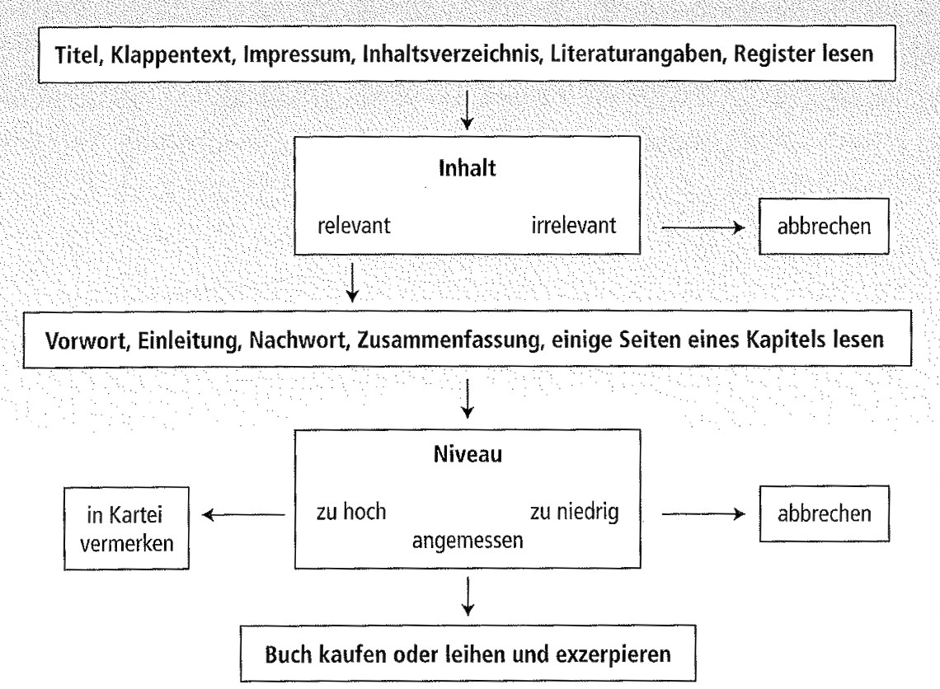
A. Preselection of literature: Cross reading

Slide 52
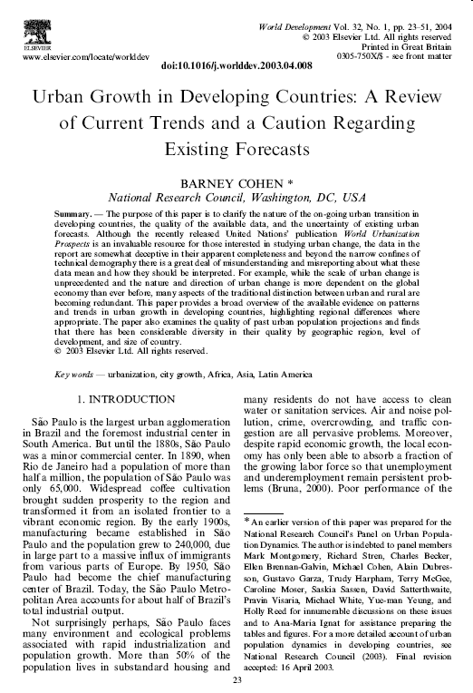
A. Preselection of literature: Cross reading

Slide 53
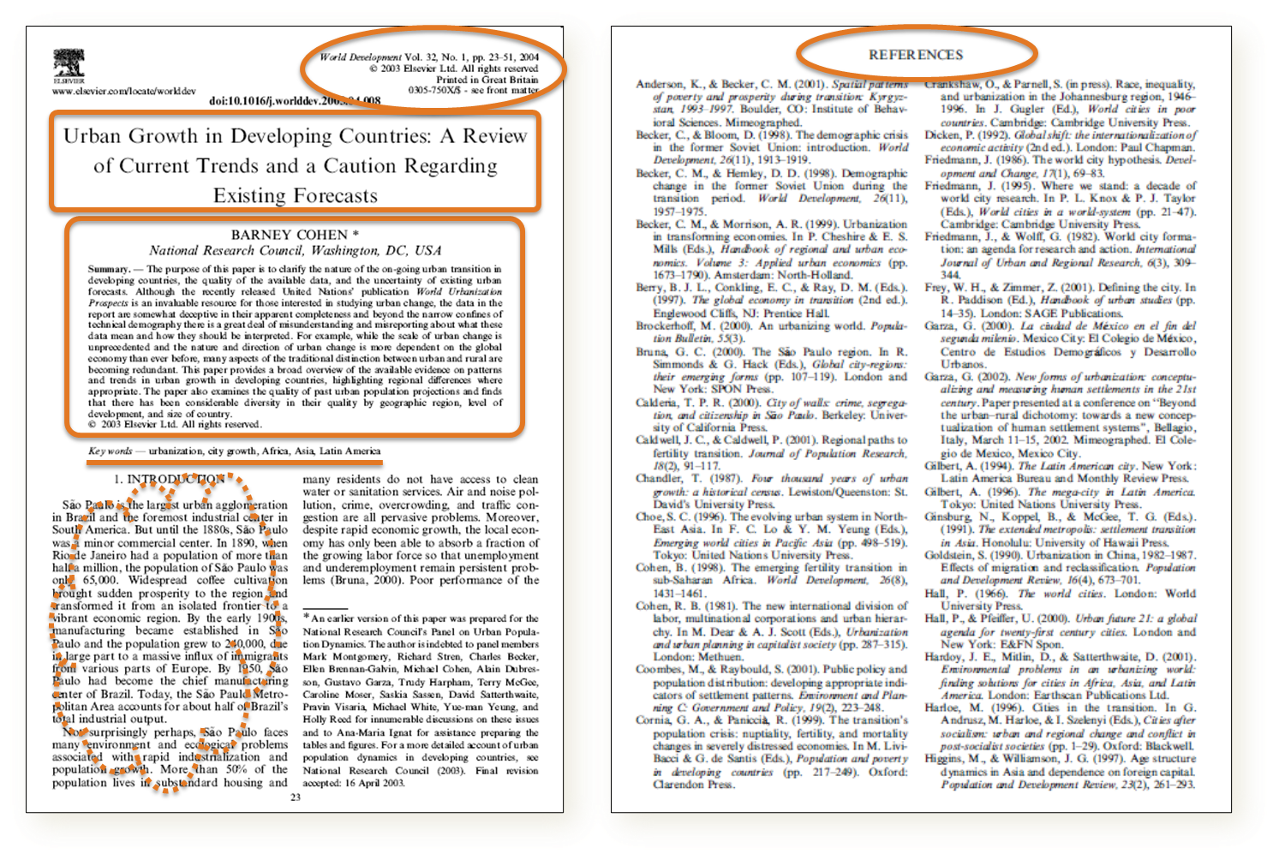
A. Preselection of literature: Cross reading

Slide 54
What does this mean for my 3,523 hits?

Slide 55
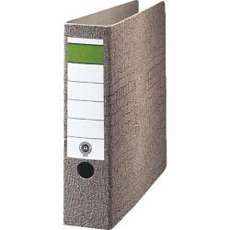
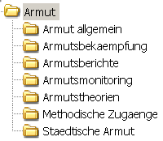






B. Focussed reading of preselected materials
👉 First of all: You need to store your materials
"Old school": copies in folders
Use dividers
Also reads well offline ;-)
PDFs in folders
Indexed search possible 👉 standardised naming
Reference management programmes
Direct import from PRIMO etc.
Keywording ("tags"), keyword search, etc.

Slide 56
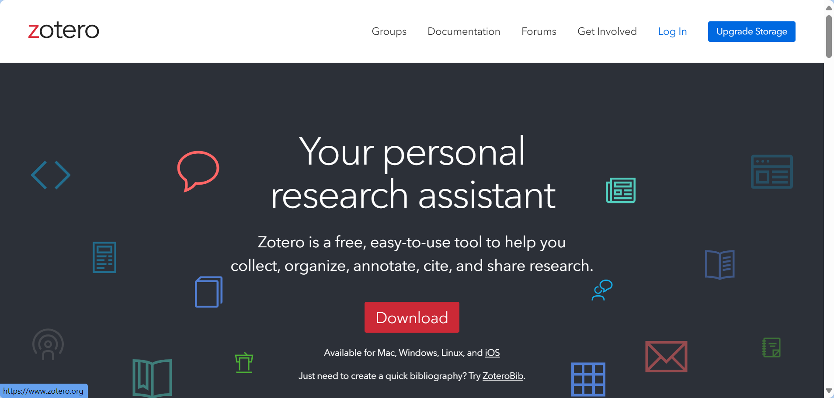
A recommendation: Zotero

Slide 57
B. Focussed reading of preselected materials
👉 Evaluate the text according to (previously defined) criteria
Assumptions for, goals of, opinions on, arguments on, facts on, etc.
Methods:
Mark keywords, text passages, quotes, etc.
finish reading 👉 underline
Marginal notes
Own structures in the text (e.g. own subheadings)
Mark questions, definitions & key statements 👉 Use of letter & symbol keys

Slide 58
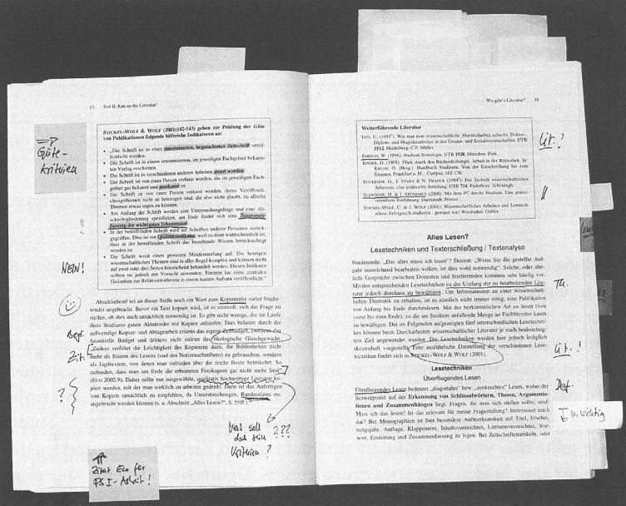
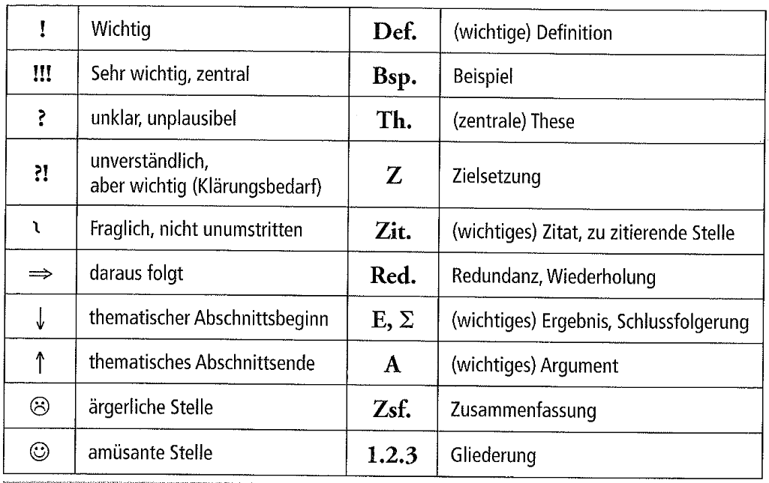

B. Focussed reading of preselected materials

Slide 59
What does this mean for my 3,523 hits?

Slide 60
C. Contextualise your materials
👉 place the text in its historical, methodological, etc. context
Key text, mainstream, marginal position etc.
Procedure:
Position of the text (e.g. the author's oeuvre
Are there similar texts?
Theoretical embedding
Are there similar texts with the same theoret. Embedding (by the same author)?
Important key terms
Textbooks, reference works & other authors
Groups of texts

Slide 61
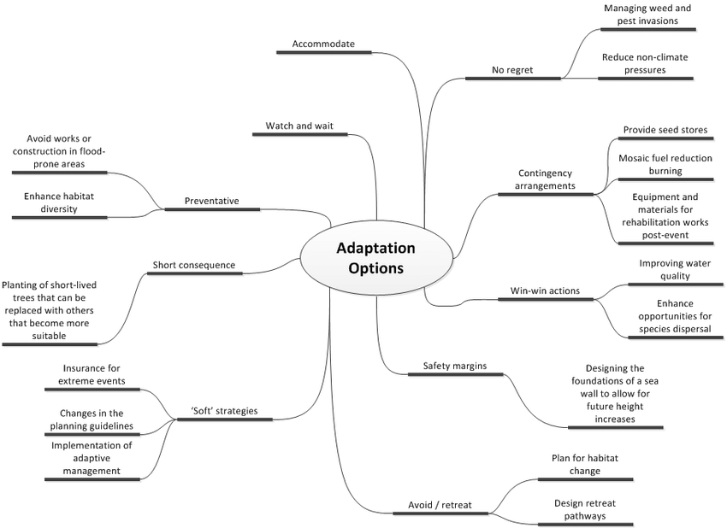
D. Selective & comparative reading
👉 prepare relevant structures from your text material
Thematic fields & their relations
Procedure:
Select information from single texts / groups of texts
Compare / arrange these information
Methods:
Excerpts
Mind & Concept Maps

Slide 62
@ Excerpts
Relevant extracts from texts :
Prepare main ideas & contents
Own questions to the text
Excerpts = more than summaries 👉 own comments
Condense:
Important definitions & concepts
Methods/context of the study
Results
important quotations
Comments:
Critique
Further use

Slide 63
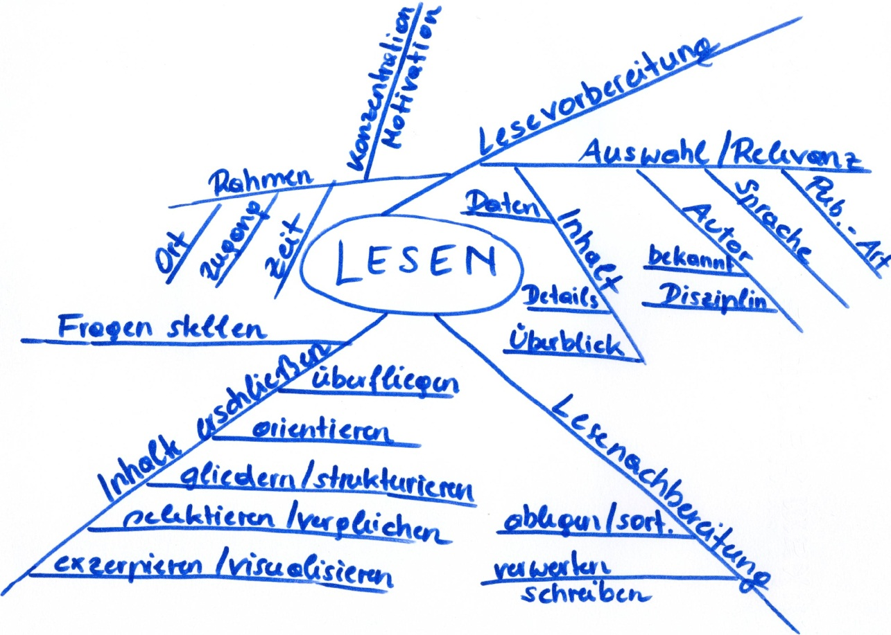
@ Mind Maps
👉 structure a topic
Central question
Central topic
Dimensions: sub-questions/sub-topics
Keywords
Results

Slide 64
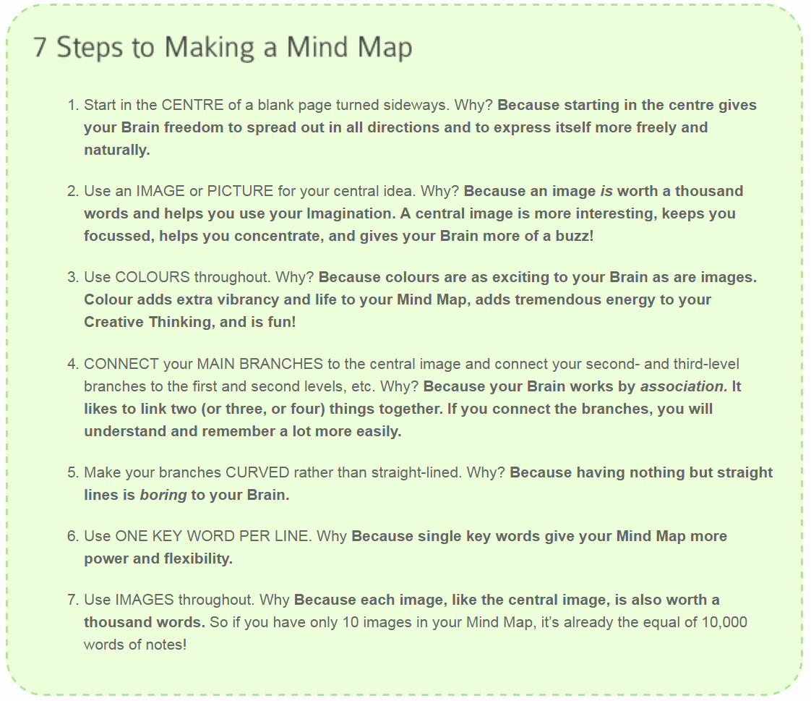
@ Mind Maps

Slide 65
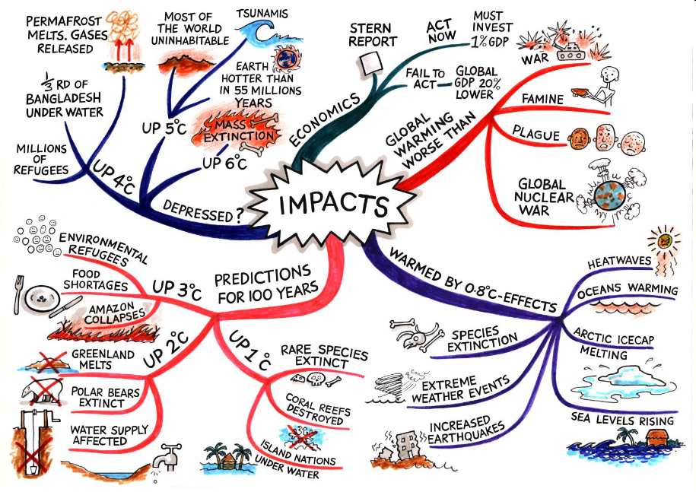
@ Mind Maps

Slide 66
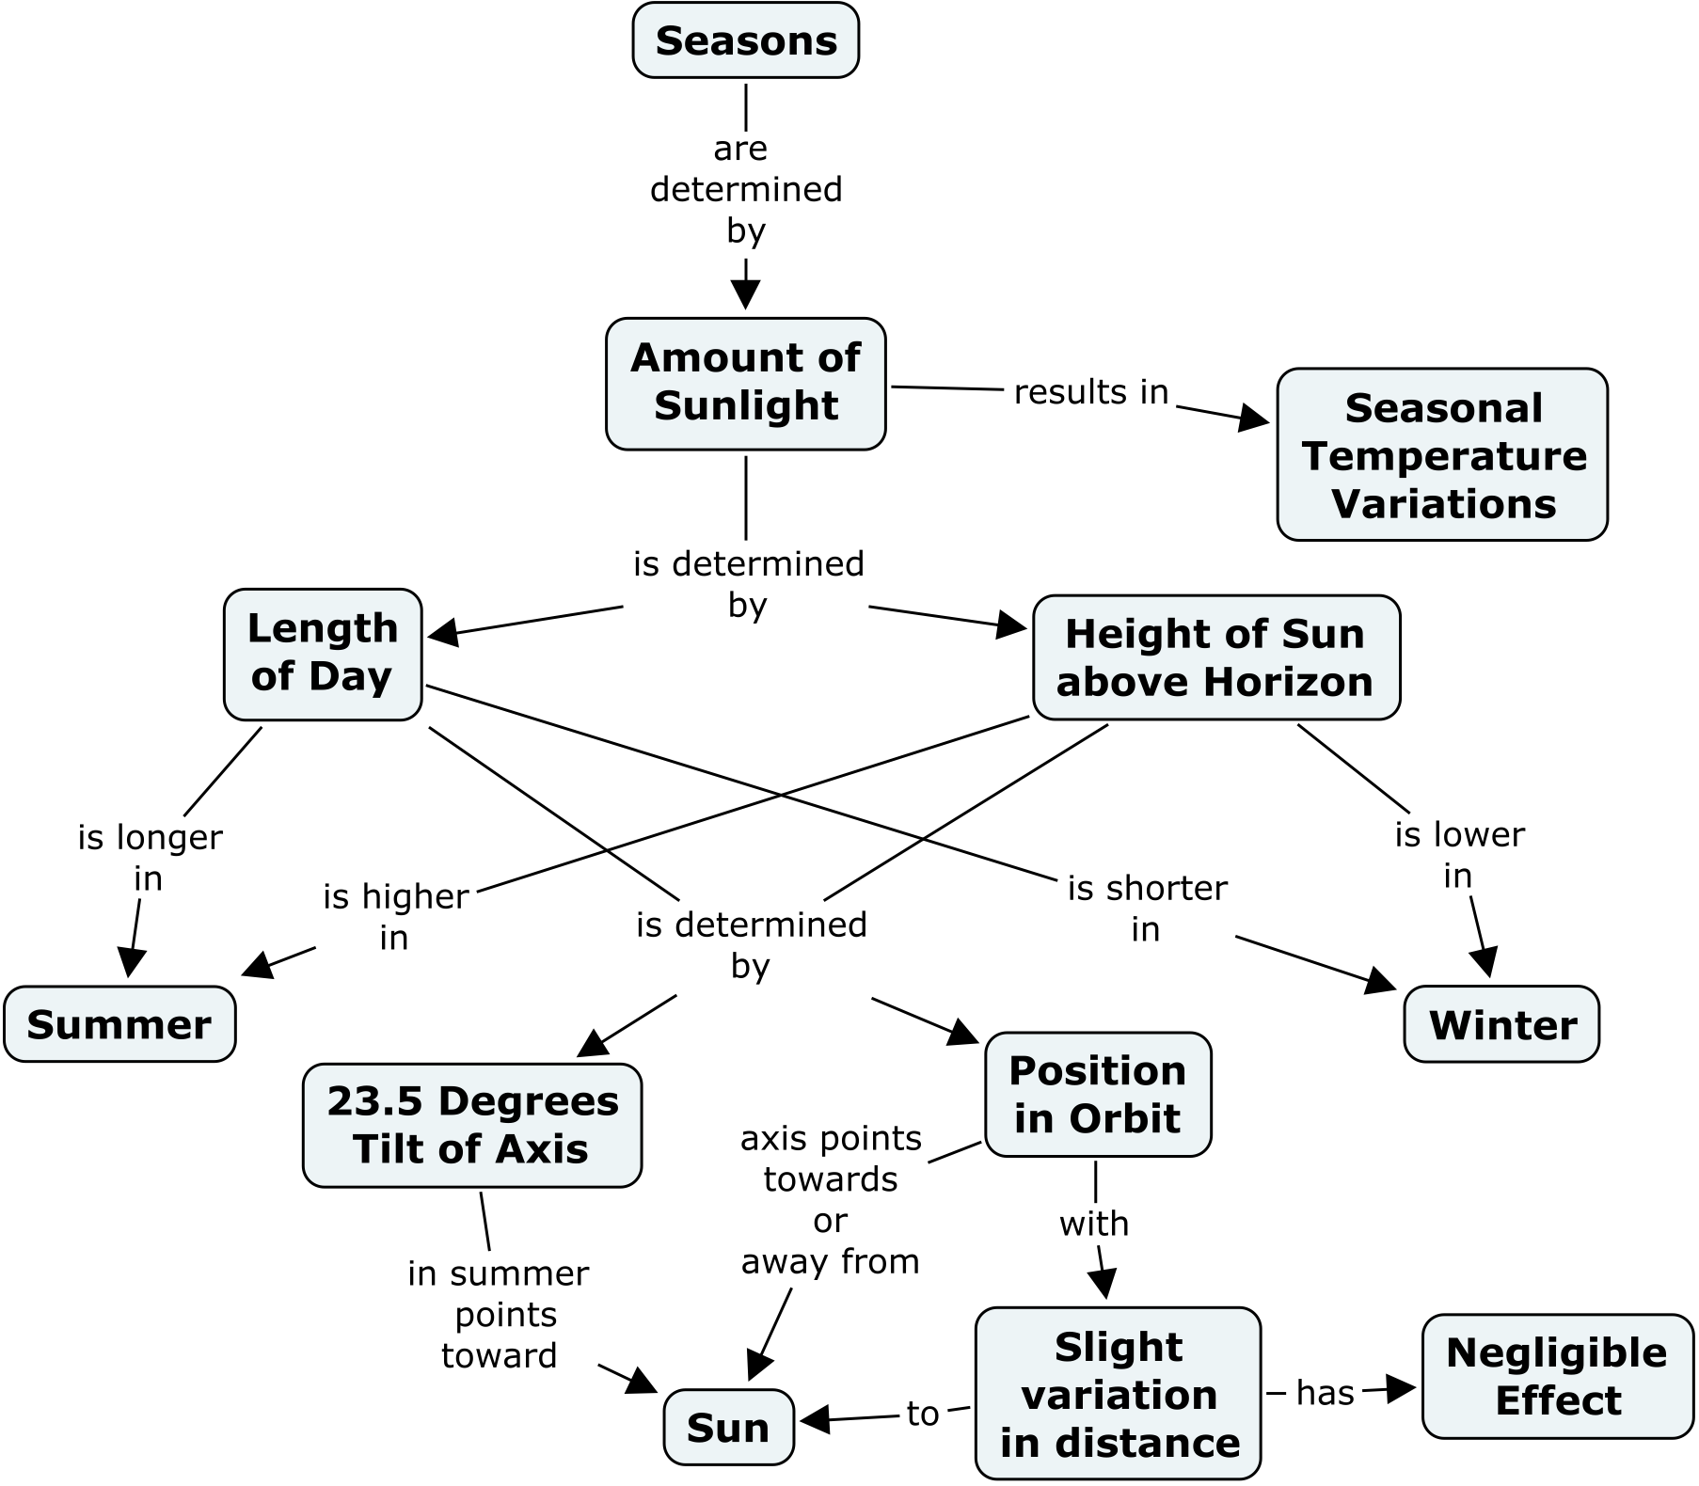
@ Concept Map
👉 transfer texts into schematic illustrations
Terms, objects
Relationships
→ Map central terms & their relationships

Slide 67
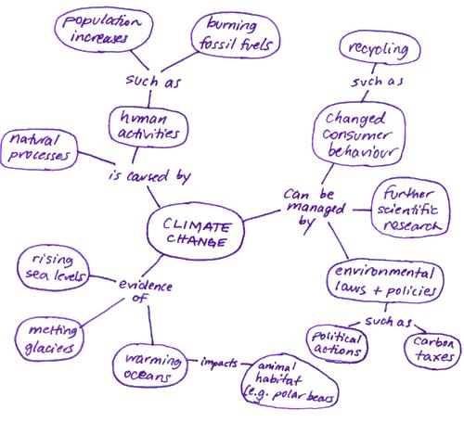
@ Concept Map

Slide 68
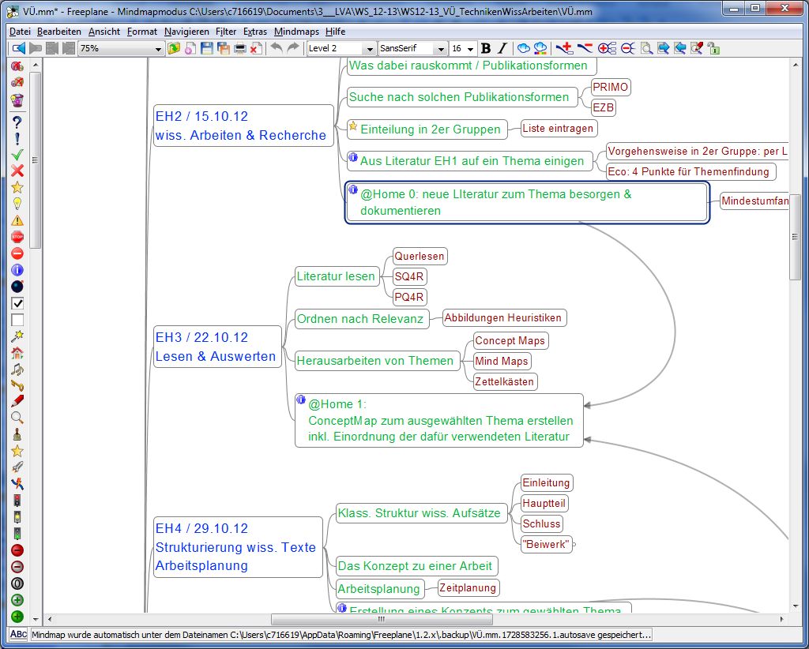
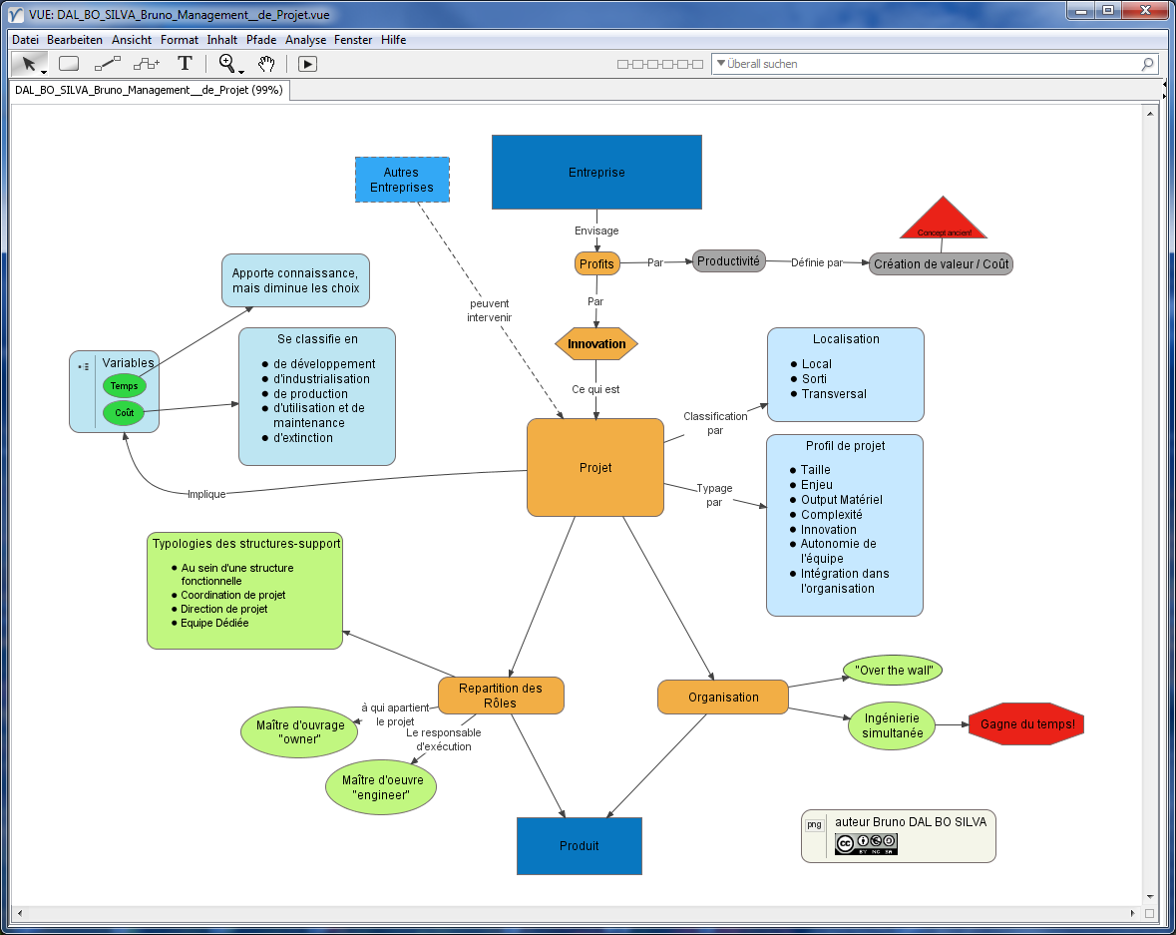
Some tools
Mind Maps:
Freeplane: http://freeplane.sourceforge.net
Freemind: http://freemind.sourceforge.net
Concept Maps:
VUE: http://vue.tufts.edu/
CMAP: http://cmap.ihmc.us/

Slide 69
What does this mean for my 3,523 hits?

Slide 70
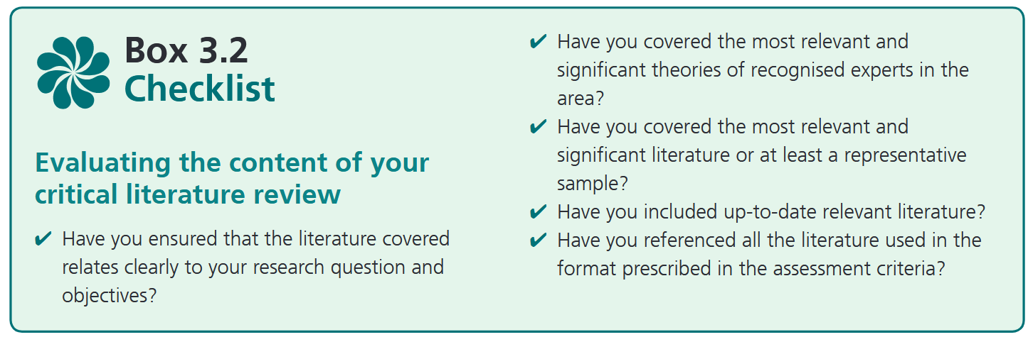
Boarding complete?

Slide 71
How to refer to it

Slide 72
Cite it, baby!
Why citation is important:
Remember: Reproducibility, Verifiability, Transparency etc.
2 reasons:
Internal: you should be able to adress your materials
Clear reference
External: You must clearly label adopted ideas, figures, data, code etc. in your work
👉 Honesty & respect

Slide 73

@ external: Referencing & Hip-Hop
Quotation as a subcultural form of recognising the achievements of others
Sampling & Hooks
Without this regonition: Plagiarism is the act of presenting someone else's work, ideas, or words as your own without proper acknowledgment, intentionally or unintentionally. It violates academic and ethical standards by failing to credit the original source.

Slide 74
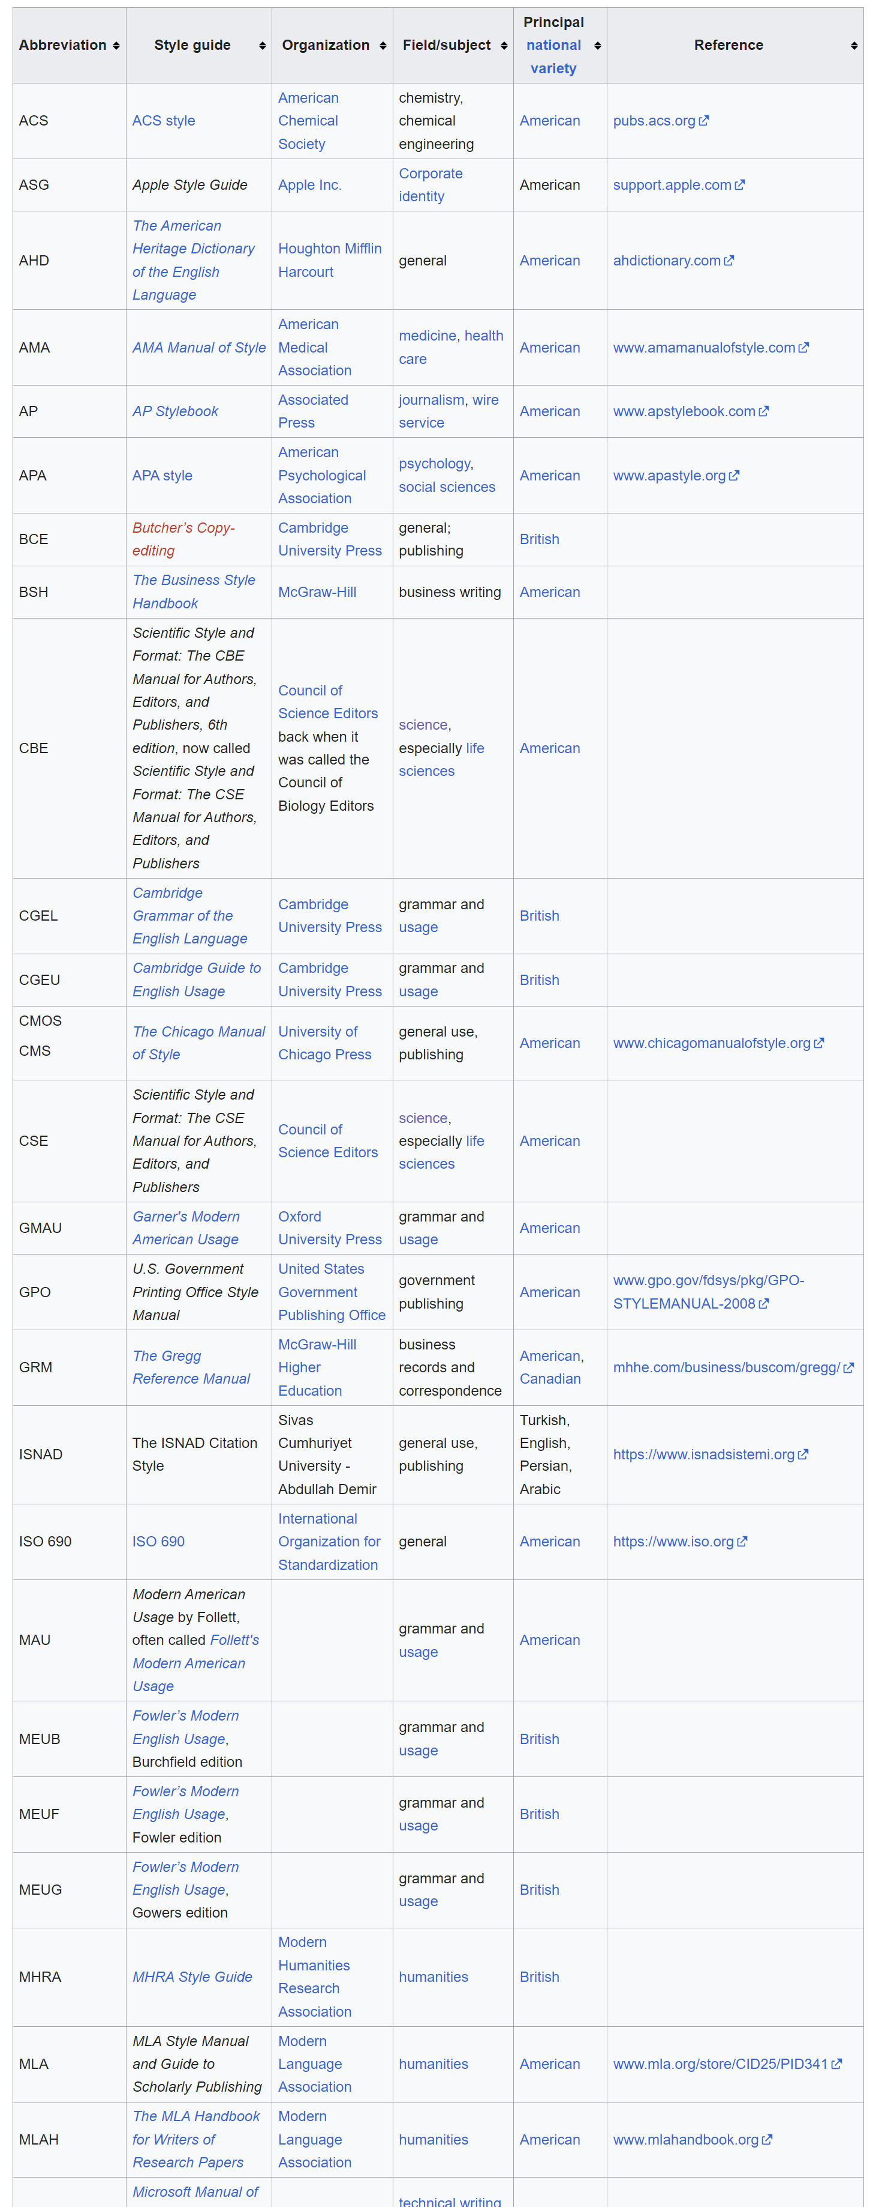
Cause we got style!
Each academic discipline 👉 own understanding of “proper” referencing of materials
Down side:
Numerous citation formats and strategies
Plus side:
Well documents standards

Slide 75
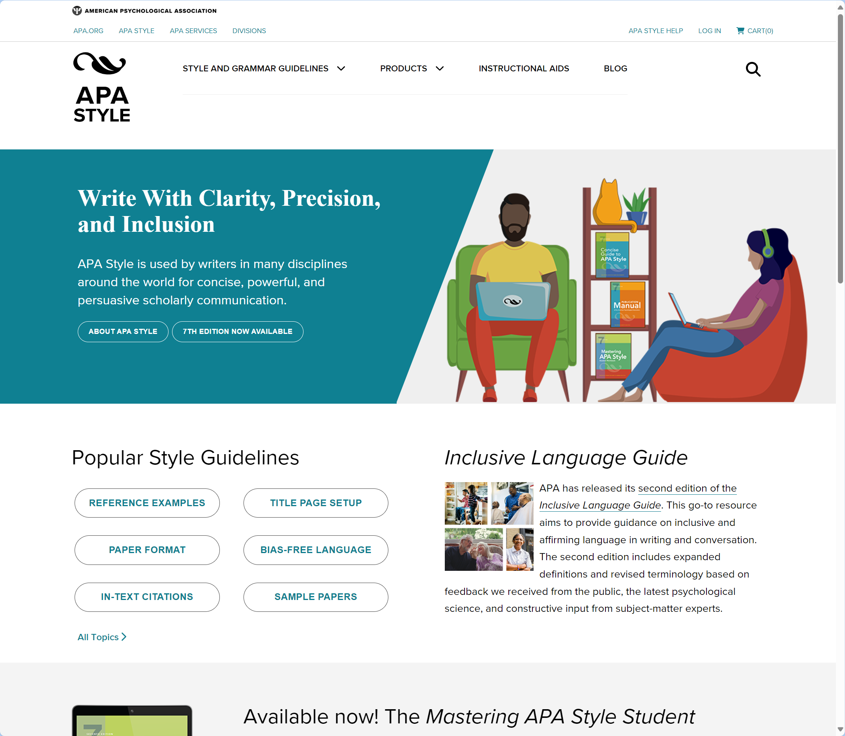
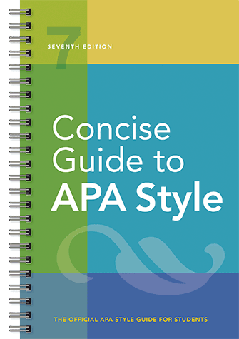
Our standard: APA Style
Notes:
American Psychological Association, 7th Edition

Slide 76
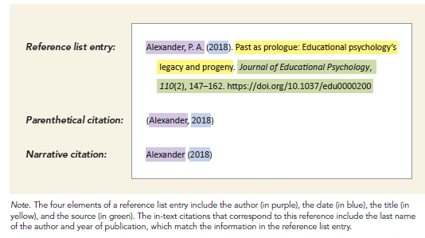
APA Style: References
👉 APA: Author-Date System
No references via “footnotes”

Slide 77
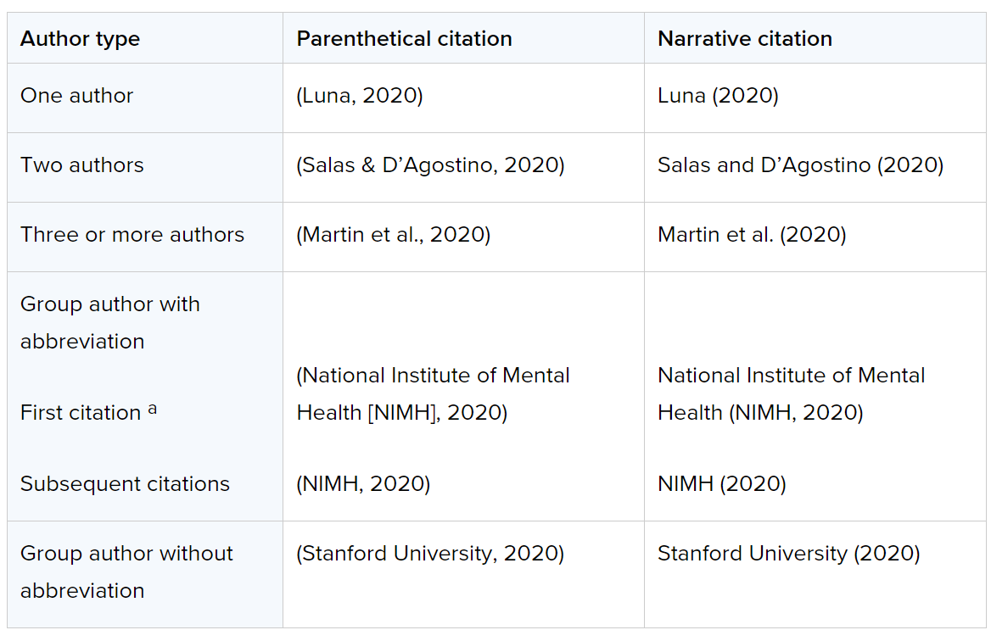
APA Style: References

Slide 78
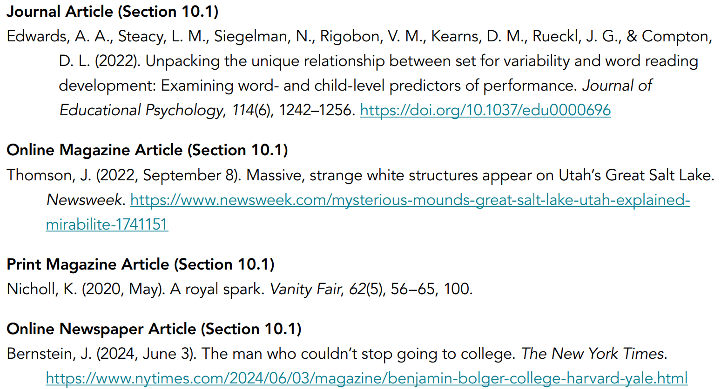
APA Style Reference Examples: Articles

Slide 79

APA Style Reference Examples: Books & Book chapters

Slide 80
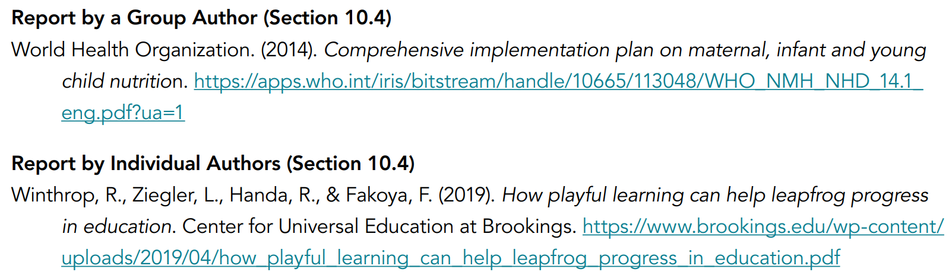
APA Style Reference Examples: Reports & grey literature

Slide 81
APA Style Reference Examples: Other materials
Data Set (Section 10.9):
O’Donohue, W. (2017). Content analysis of undergraduate psychology textbooks (ICPSR 21600; Version V1) [Data set]. Inter-university Consortium for Political and Social Research. https://doi.org/10.3886/ ICPSR36966.v1
YouTube Video (Section 10.12):
Above The Noise. (2017, October 18). Can procrastination be a good thing? [Video]. YouTube. https://www.youtube.com/watch?v=FQMwmBNNOnQ
Podcast Episode (Section 10.13)
Santos, L. (Host). (n.d.) Psychopaths and superheroes (No. 1) [Audio podcast episode]. In The happiness lab with Dr. Laurie Santos. Pushkin Industries. https://www.happinesslab.fm/season-2-episodes/ episode-1

Slide 82
How to sort a APA Style reference list
Alphabetical Order:
Arrange entries alphabetically by the first author's last name.
If multiple works have the same author, order them by publication year (earliest first).
Same Author and Year:
Use lowercase letters (e.g., 2021a, 2021b) to differentiate works with identical authors and publication years.
No Author:
Use the title to alphabetise (ignore "A," "An," or "The" at the start of the title).
No Year:
Use n.d. (“no date”)
they come before dated references by the same author
multiple "n.d." references by the same author: alphabetise them by title

Slide 83
How to format a APA Style reference list
General Formatting:
Double-spacing throughout
Use a hanging indent (first line flush left, subsequent lines indented)
Author Names:
List last names followed by initials (e.g., Smith, J. D.).
For up to 20 authors, list all; for more than 20, list the first 19 followed by an ellipsis and the final author
Publication Year:
Place in parentheses after the author’s name, followed by a period.
Titles:
Italicize book titles and journal names.
Use sentence case for article titles, but title case for journal names.
URLs and DOIs:
Include DOI if available; otherwise, provide the full URL for online sources.
Use the format: https://doi.org/xxxx.

Slide 84
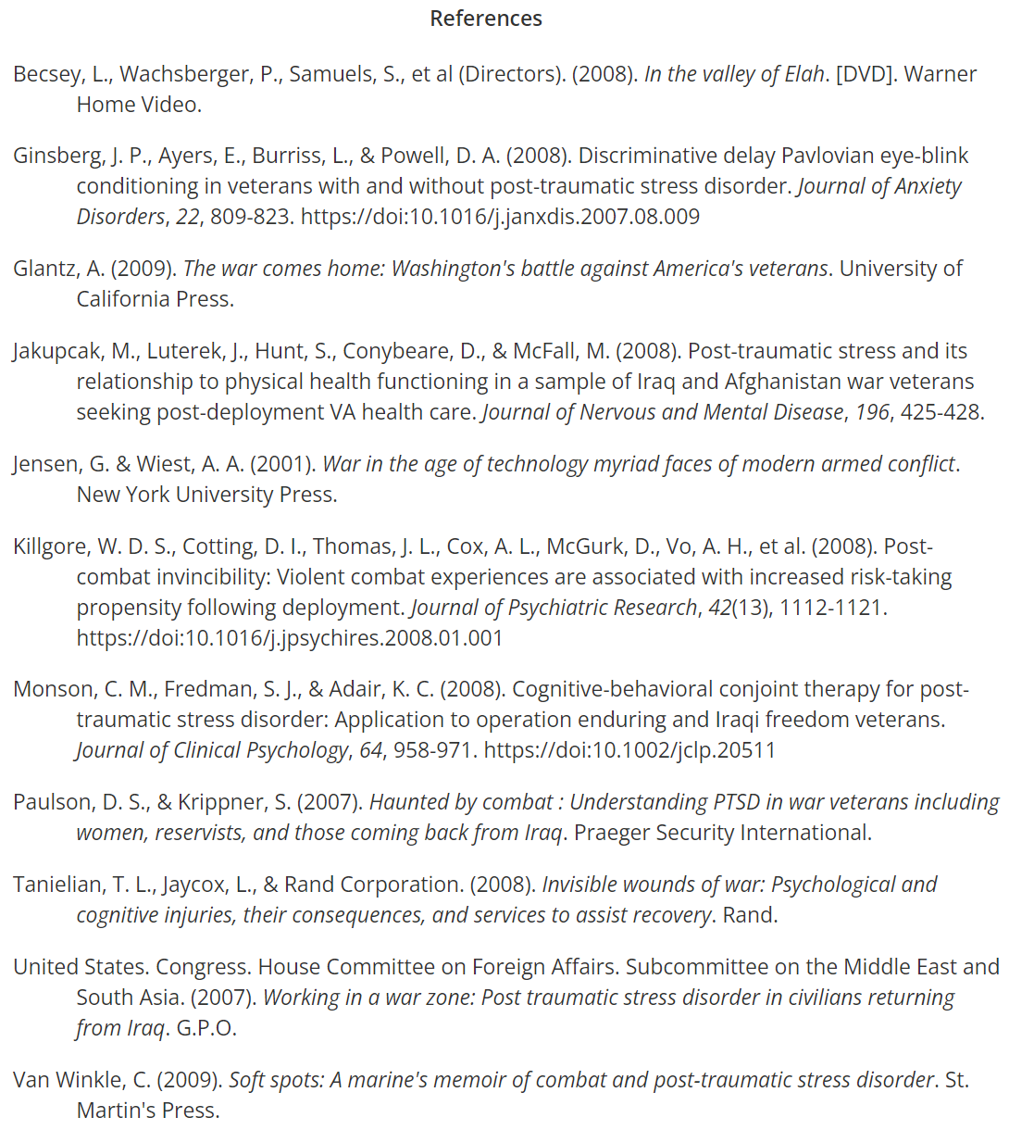
An APA Style formatted bibliography

Slide 85
Assignment 1: Search, Read & Structure

Slide 86
Your first assignment: A literature review
Form groups of 2:
SME_Groups.xlsx in Teams

Slide 87
Your first assignment: A literature review
What? | Length
Cover page (incl. group number) | 1 page
Title with clear reference to the chosen topic | ─
Introduction to the topic & it’s relevance | ~ 0,25 pages
Documentation search strategy | ~ 0,5 Seiten
Mind Map for your topic | ~ 1 page
Up to three possible research questions | ~ 0,25 pages
Bibliography: 5 most relevant materials on your topic | ~ 0,75 pages

Slide 88
1. Assignment: Cover page
Required information:
Name of the university & study programme
Title of the course, semester & name of the lecturer
Title & subtitle of the thesis
Group number
Name of the authors & matriculation numbers
Place & date of submission
No page number on title page!
→ The look: simple & professional
No fancy fonts, decorative frames etc.
→ Image: objective overall impression

Slide 89
1. Assignment: Written report
All pages:
Page numbers at the bottom
Except cover page
Header:
Title of the report

Slide 90
Your first assignment: A literature review
Hand in your report:
1 PDF A4 for each group
Name of the file: G1_<short title>.pdf
Teams: Upload in folder “1. Assignment”
📅 Deadline: 23.11.25, 22:00

Slide 91
Wrap it up

Slide 92
Wrap it up
A statement can be either true or false
A hypothesis assumes a relationship between two variables
A theory are assumptions about causal relationships between several variables
Research process most often try to develop hypotheses, evaluate them or describe objects/processes
Literature formats range from peer-reviewed journal articles to videos
Unlocking knowledge from literature is a layered and hermeneutic process

Slide 93
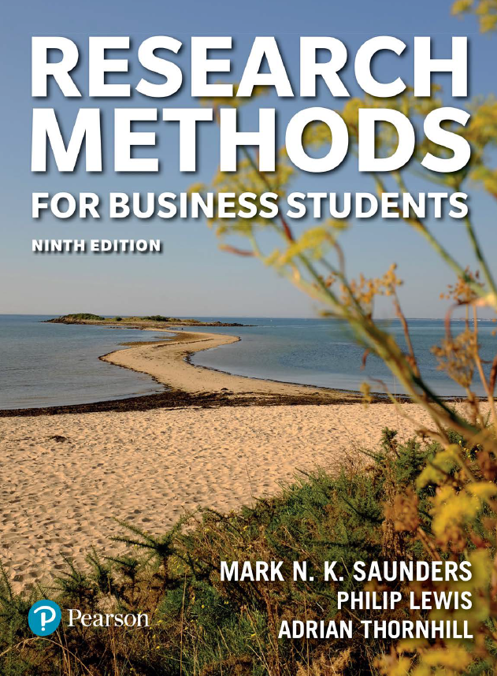
Till next session:
Chapters 3.1 & 3.5 on critically reviewing the literature from Saunders et al. (2023)

Slide 94
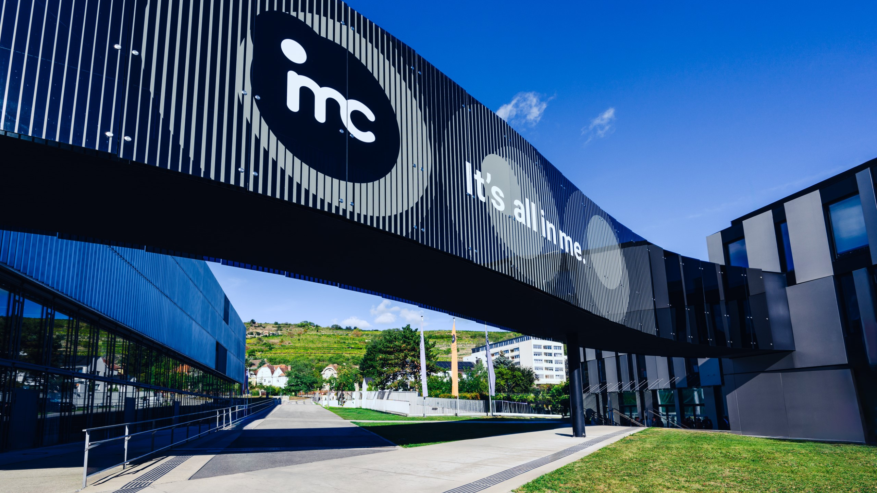
So long & cheerio!

